Slide 1
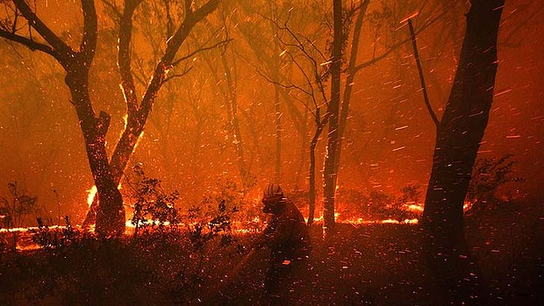
Estimating Firebrand Shape & Size from Video Images
Navya, Hemani
Rohit & Kuldeep
AI-2 Final Project
Prof. Ignacio Becker
Prof. Pavlos
Vishnu M
Sakthisree Venkatesan
Harsh Vardhan Goyal
Yashraj Wani
Meghana Sarkonda
Wildland Fires: Life and Property
http://www.smh.com.au/entertainment/art-and-design/bushfire-photos-teach-lessons-of-the-flames-on-show-in-nsw-library-20140124-31e7g.html (Photo: Wolter Peeters)
Univ.AI
Notes:
A Rural Fire Service firefighter retreats from the flames while protecting homes near Dargon, in the Blue Mountains, in October last year (2013)

Slide 2
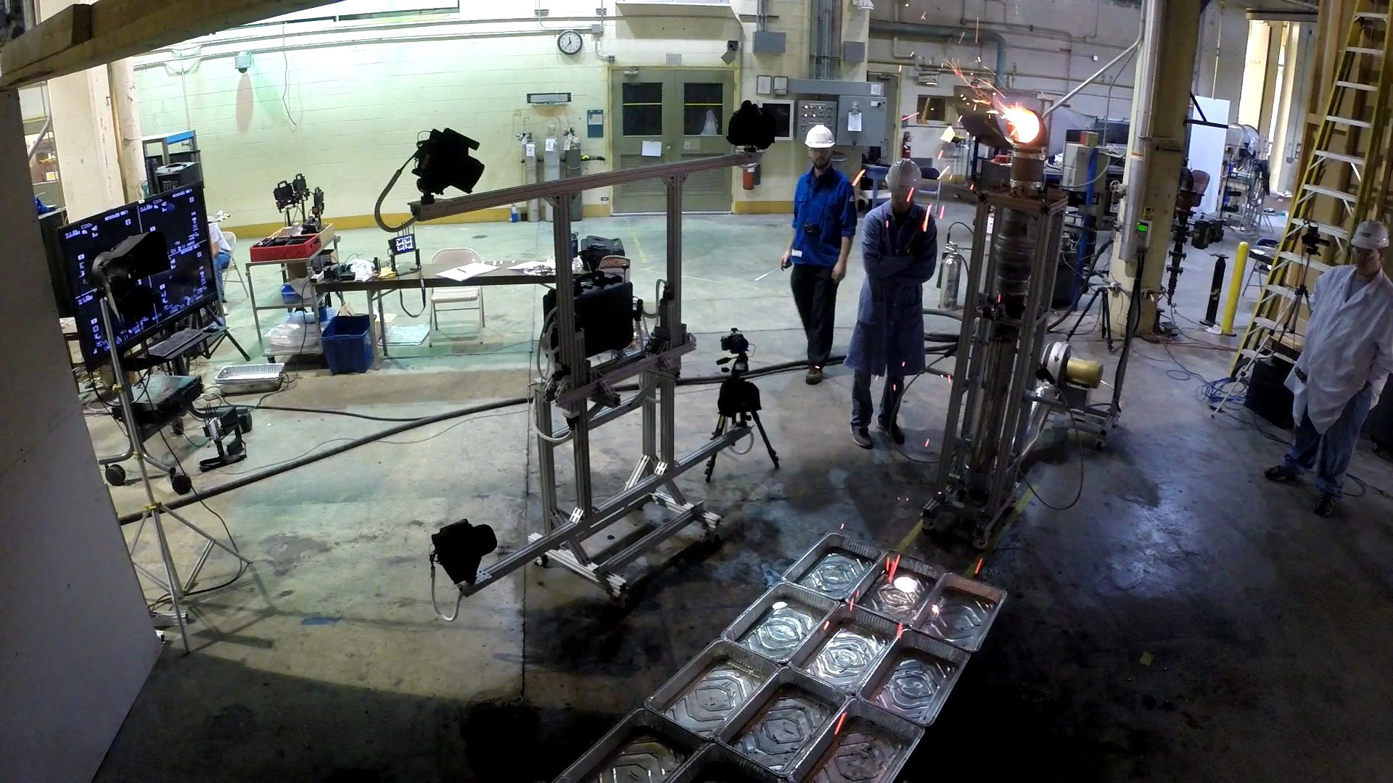
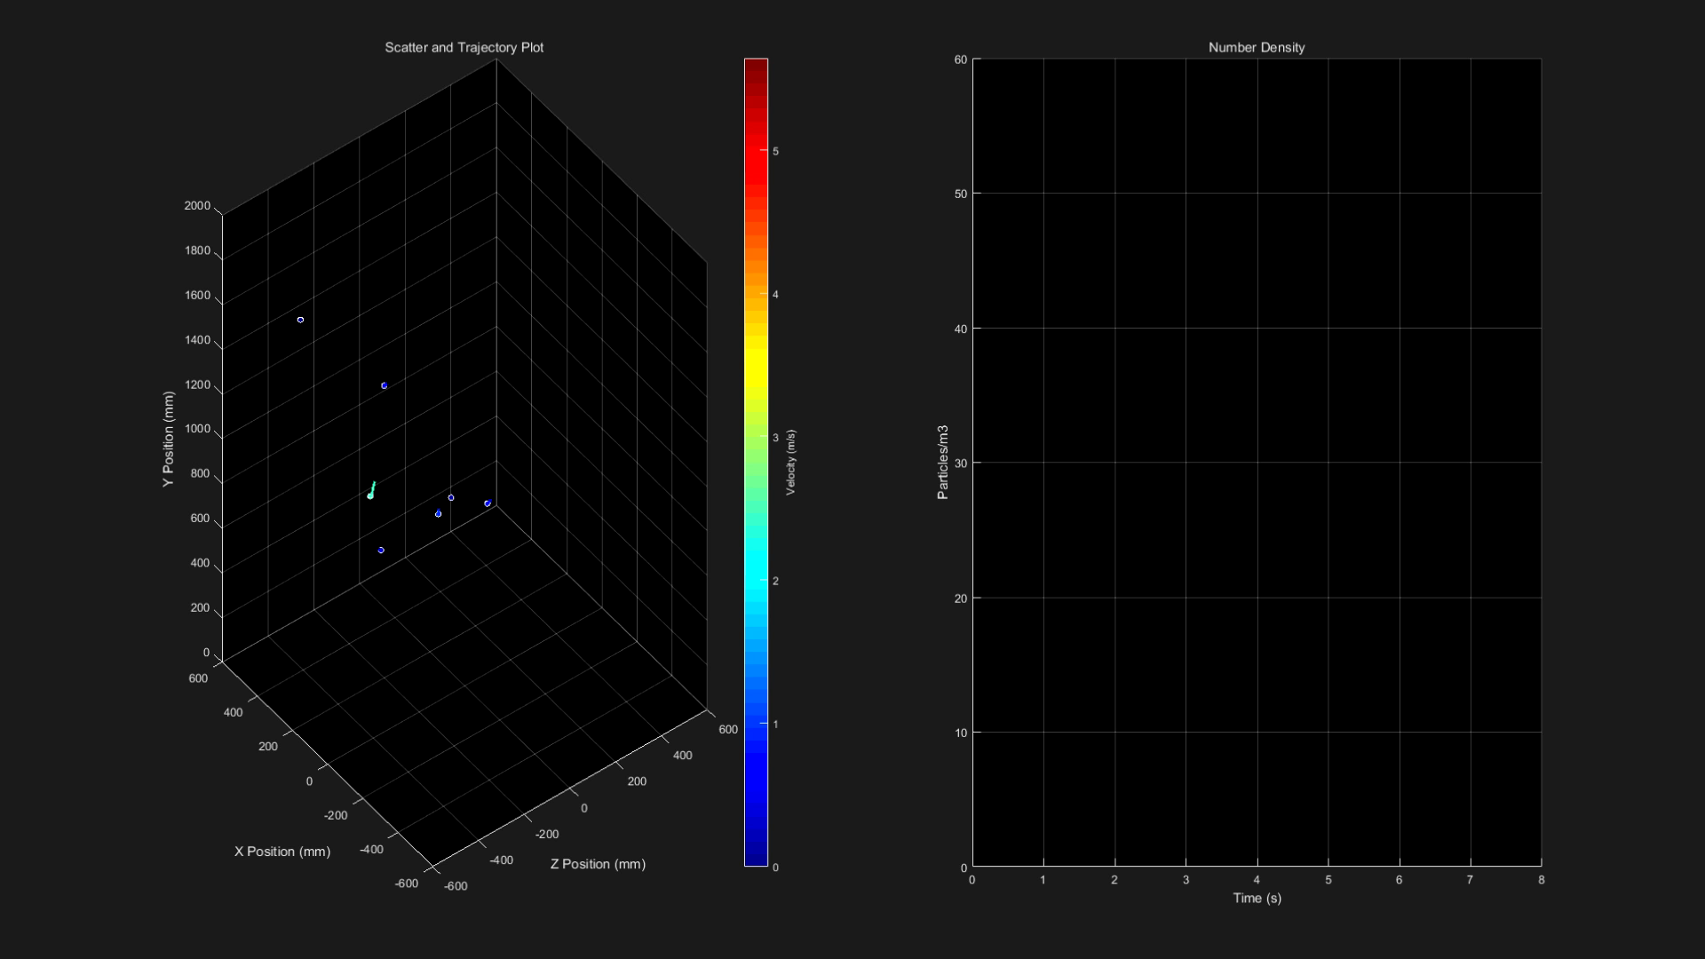
Artificial Firebrand Shower – Data Collection
Camera 1 & 2
3-D Firebrand motion
Generating Training Data
Camera 3 & 4
Emberometer placed near a firebrand generator
3D-reconstructed firebrand trajectories / location
Notes:
NIST Emberometer is a powerful diagnostic tool for tracking and visualizing the motion of firebrands in a real fire scenario.
In these tests, the emberometer is placed in the vicinity of a firebrand generator that artificially re-creates a firebrand shower. Data is recorded as airborne firebrands travel throughout the system control volume. Time-resolved 3D firebrand motions are shown in the right figure.

Slide 3
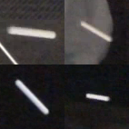
Typical Images from Firebrand Shower
Cylindrical Dummy Particle (71 x 71 x 1 pixels)
Length : 50.6 +- 0.1 mm, Diameter : 6.6 +- 0.3 mm
Quad image :142 x 142 x 1 pixels
Quad Image : Data Collection
Starting point for Deep Learning Analysis
Camera A
Camera B
Concatenate
Camera C
Camera D
Univ.AI
Notes:
The data collected from the Emberometer is the starting point for our research

Slide 4
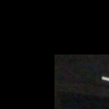
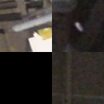
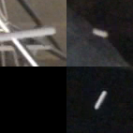
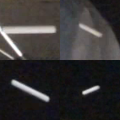
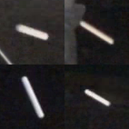
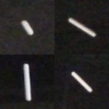
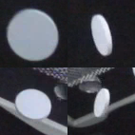
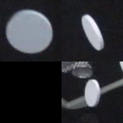
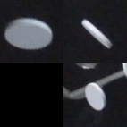
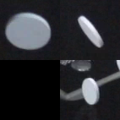
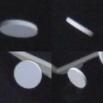
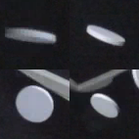
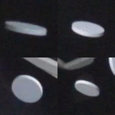
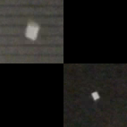
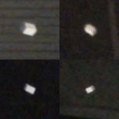
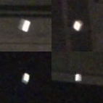
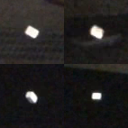
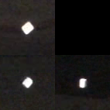
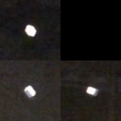
Sequence of Quad Images Particle Location & Orientation Evolving with Time
Training Data
Cylinder : Diameter 6.6 ± 0.3 mm; length 50.6 ± 0.1 mm
Cylinders
Disk : Diameter 49.0 mm; Thickness 6.2 mm
Disks
Cubes : Length 7.8, 8.1 and 12.9 mm ± 0.4mm
Cubes

Slide 5
Research Goals :
Research Idea
To protect communities from firebrand ignition, it is critical to understand the shape, size and characteristics of firebrand shower.
Research Questions:
Can CNN trained on video images collected from a system of four cameras accurately classify firebrands (as cylindrical, spherical or disk-shaped firebrands)
Can CNN combine image and non-image data with regression techniques to predict firebrand volume, length, width, height, orientation / rotation angles (3)
Univ.AI

Slide 6
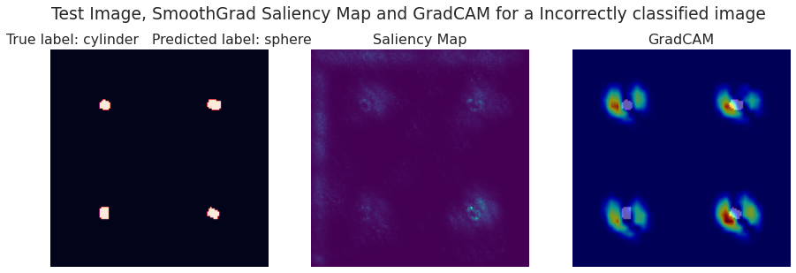
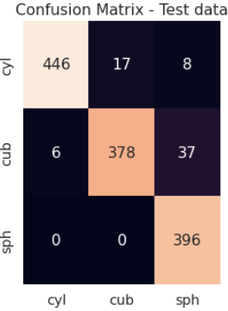
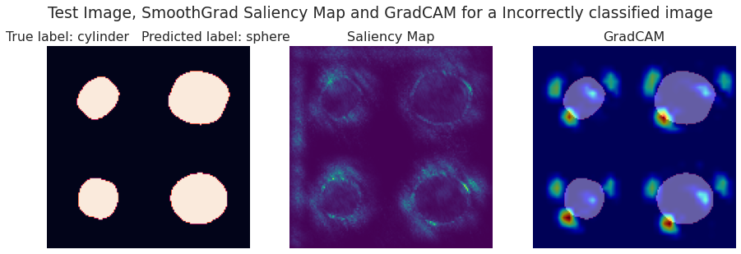
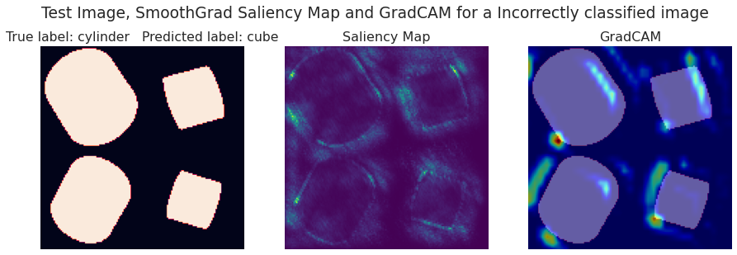
Classifying Firebrands:
Which Images are Mis-classified (5 %)?
Modified LeNET Architecture
Test Accuracy : 0.95
Image Backpropagation Grad-CAM
Is it a Disk, Sphere or Cylinder?
True : Cylinder
Predicted : Sphere
85 %
True Labels
Sph Cube Cyl
True : Cylinder
Predicted : Sphere
7 %
Cyl Cube Sph
Challenge : Design Input Layer
Single Channel Quad Image?
Mutli-Channel (20) Image?
Organizing Video Data?
Exploratory Studies :
Data Augmentation, Regularization
MobileNet, Transfer Learning
PyTorch, LambdaCallbacks
True : Cylinder
Predicted : Cube
8%

Slide 7
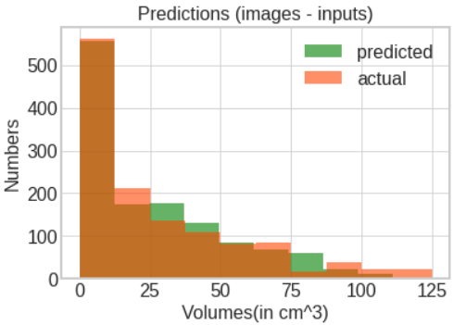
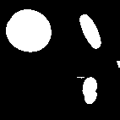
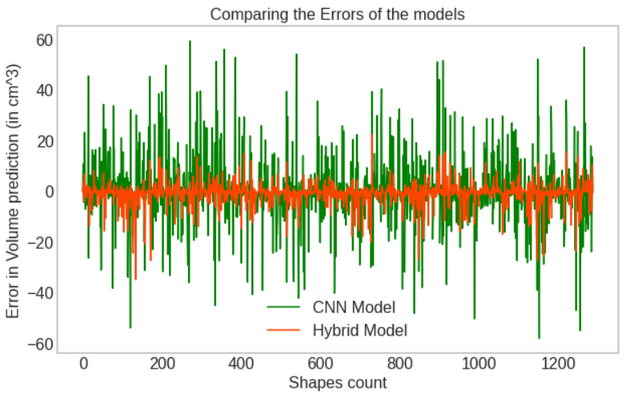
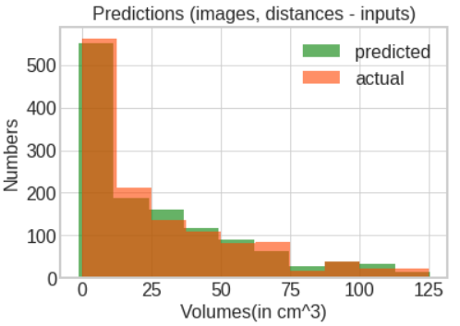
Estimating Volume of Firebrands from Images
Image (only) as Input Feature
Multiple Inputs and Mixed Data Analysis
CNN (LeNET)
Flatten
Dense
Softmax
CNN Model
R2 score = 0.80
Number
Concatenate
Tabular Data
ANN Dense
Linear
Activation
Dense
Mixed Data Regression Analysis
Volume (cm^3)
Image and Distance as Input Feature
Test Data
Hybrid Model
R2 score = 0.97
Number
Error (cm^3)
Count
Volume (cm^3)

Slide 8
Impact of Research Project / Conclusions
Future Work / Discussion
Wildfires – Global Problem – Loss of Life and Property.
Firebrands are responsible for rapid growth and spread of wildfires.
Understanding firebrand characteristics is critical to protect communities.
Neural Networks can accurately classify firebrand (accuracy 95 %).
Networks with mixed data and multiple inputs can predict firebrand volume (R2 score 0.97)
Irregular shaped firebrands !! (Field data is much more complex)
Impact : Understanding firebrand characteristics will lead to development of mitigation strategies.
Protect / strengthen communities from firebrand showers.
Univ.AI

